Slide 1

Testing and Verification (CSC7056/CSC3056)
Aidan McGowan
Maintenance Testing

Slide 2

Maintenance Testing
Once a system is deployed it may be in service for years.
During this time the system and its operational environment is often corrected, changed or extended.
Testing that is provided during this phase is called maintenance testing.

Slide 3
Maintenance Testing
Maintenance testing is done on an existing system
Triggered by
  Modifications
  Migration
  Retirement of software

Slide 4
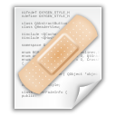
Modifications include
  Planned enhancements (e.g. release based) e.g. new feature
  Corrective and emergency changes
  e.g. accumulated bug fixes, security issue
  Changes in environment
    Operating system or database updates
    Patched to fix newly exposed vulnerabilities in the operating system

Slide 5

Migration and retirement
Migration is moving from one platform to another
Also known as (conversion testing)
Requires operational tests of the new environment as well as the new software.
Maintenance testing for the retirement of a system may include the testing of the data migration or archiving if long term data- retention is required.

Slide 6


Impact analysis
Impact analysis is basically analysing the impact of the changes in the deployed application or product.
It tells us about the parts of the system that may be unintentionally affected because of changes in the application and therefore need careful regression testing.
This decision is taken together with the stakeholders.

Slide 7
Testing through the lifecycle
Sample questions..

Slide 8
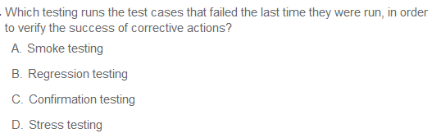
Testing through the Lifecycle
Notes:
C

Slide 9
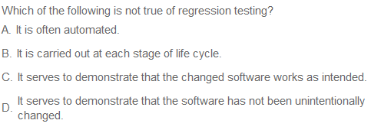
Testing through the Lifecycle
Notes:
A – Indeed the goal is to try an ensure that as much of the regression tests are automated as possible. This speeds up the fix and confirm process.
B – (the correct answer) as per ISTQ definition regression testing is only on software so can’t happen before component testing
C – Only if included with Confirmation Testing then Regression does serve to demonstrate that changed software works as intended. Although this is also an accurate definition of Confirmation Testing.
D – this is the primary goal of Regression testing (and arguably the best definition of these options)

Slide 10
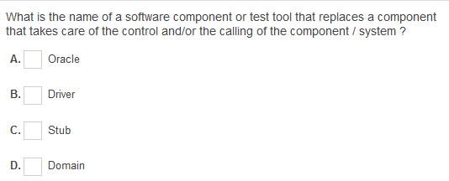
Testing through the Lifecycle
Notes:
B

Slide 11
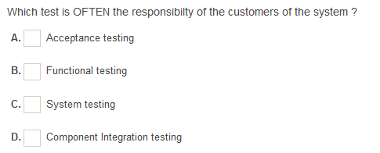
Testing through the Lifecycle
Notes:
A

Slide 12
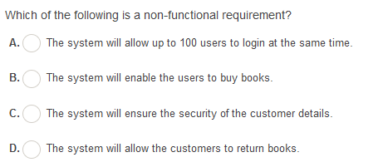
Testing through the Lifecycle
Notes:
A

Slide 13
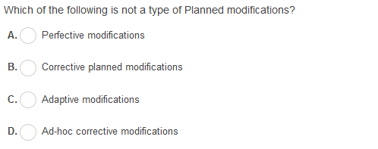
Testing through the Lifecycle
Notes:
D

